Slide 1
Building iOS Swift apps
5030-201720_MCS5993_M: 5030-Topics in Computer Science
5031-201720_MCS4993_M: 5031-Topics in MA/CS

Slide 2
Agenda
Chapter 4 from Nobledesktop book

Slide 3
Save your work
git add .
git commit –m “Chapter 3”
Notes:
Will probably just add the new images

Slide 4
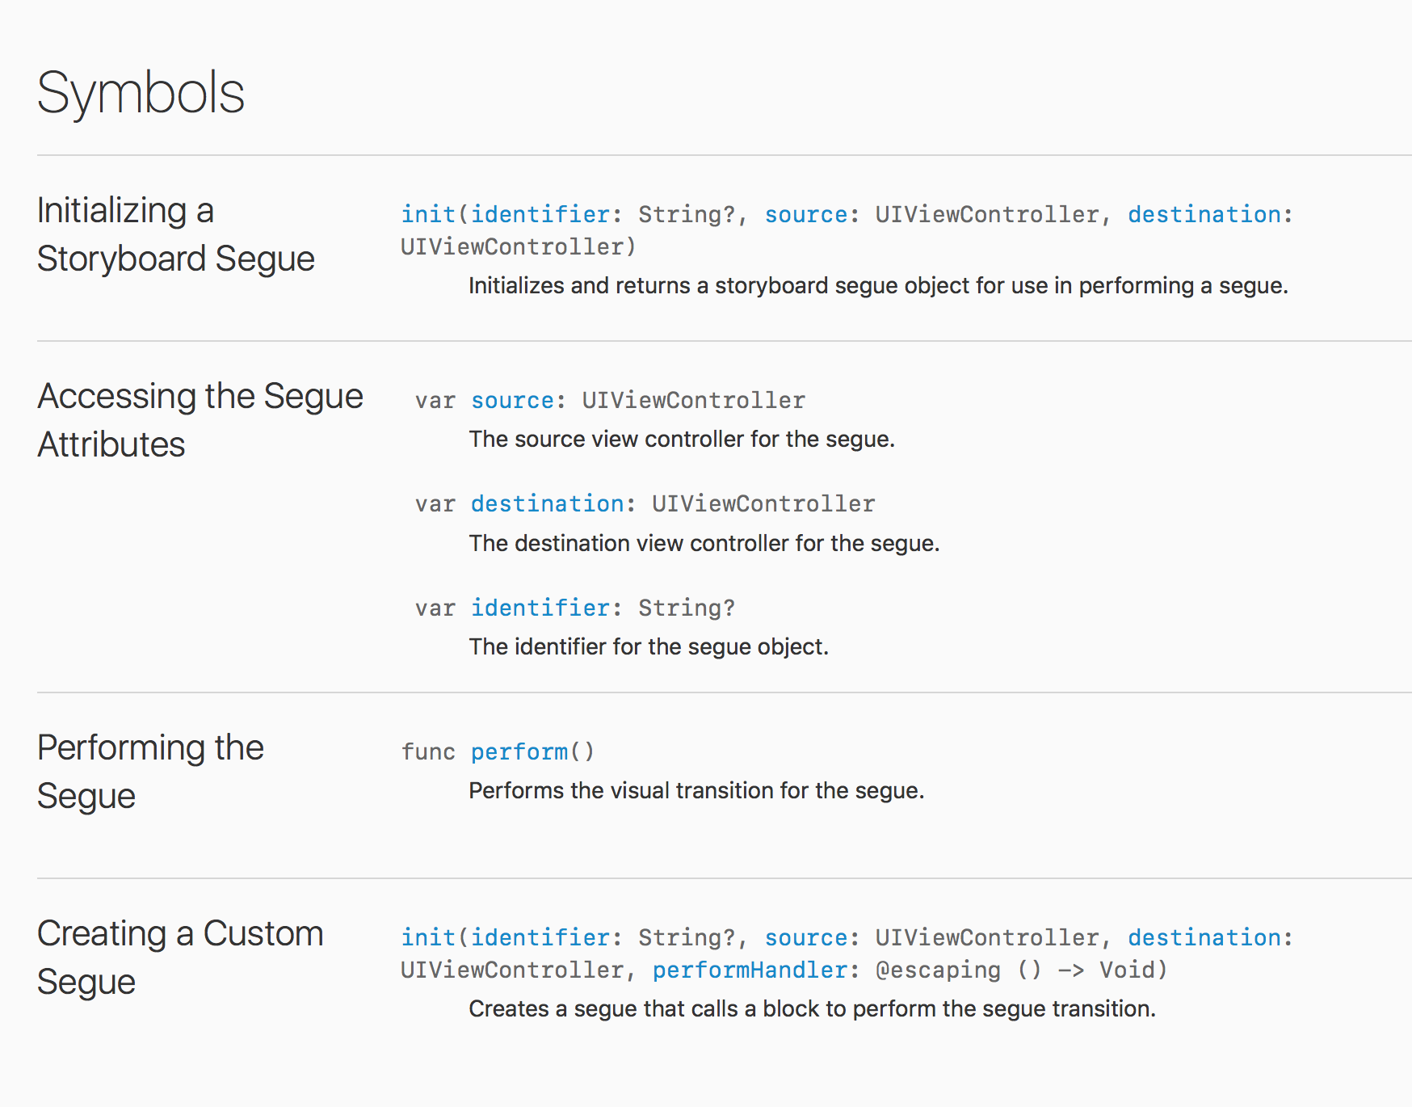
Chapter 4
Notes:
Click on UIStoryBoardSegue in the help section

Slide 5
prepareForSegue
if (segue.identifier == "showDetail") {
if let indexPath = self.tableView.indexPathForSelectedRow { let bandsDetailViewController:BandsDetailViewController = segue.destination as! BandsDetailViewController
}
}
Notes:
Inside this method we wrote an if statement that checks to see which segue was triggered.
If that segue’s identifier is equal to showDetail then the code inside the if statement is executed.
showDetail is the name we’ll assign to our segue

Slide 6
prepareForSegue
if (segue.identifier == "showDetail") {
if let indexPath = self.tableView.indexPathForSelectedRow {
let bandsDetailViewController:BandsDetailViewController = segue.destination as! BandsDetailViewController
}
}
Notes:
Inside the first if statement is another if statement which asks the current table view for the index path of the row that was selected.
The index path is how we know which row was tapped. This will help us set the correct info for each band later.

Slide 7
prepareForSegue
if (segue.identifier == "showDetail") {
if let indexPath = self.tableView.indexPathForSelectedRow {
let bandsDetailViewController:BandsDetailViewController = segue.destination as! BandsDetailViewController
}
}
Notes:
The first line of code inside the second if statement sets the view controller we are transitioning to, which is BandsDetailViewController.

Slide 8
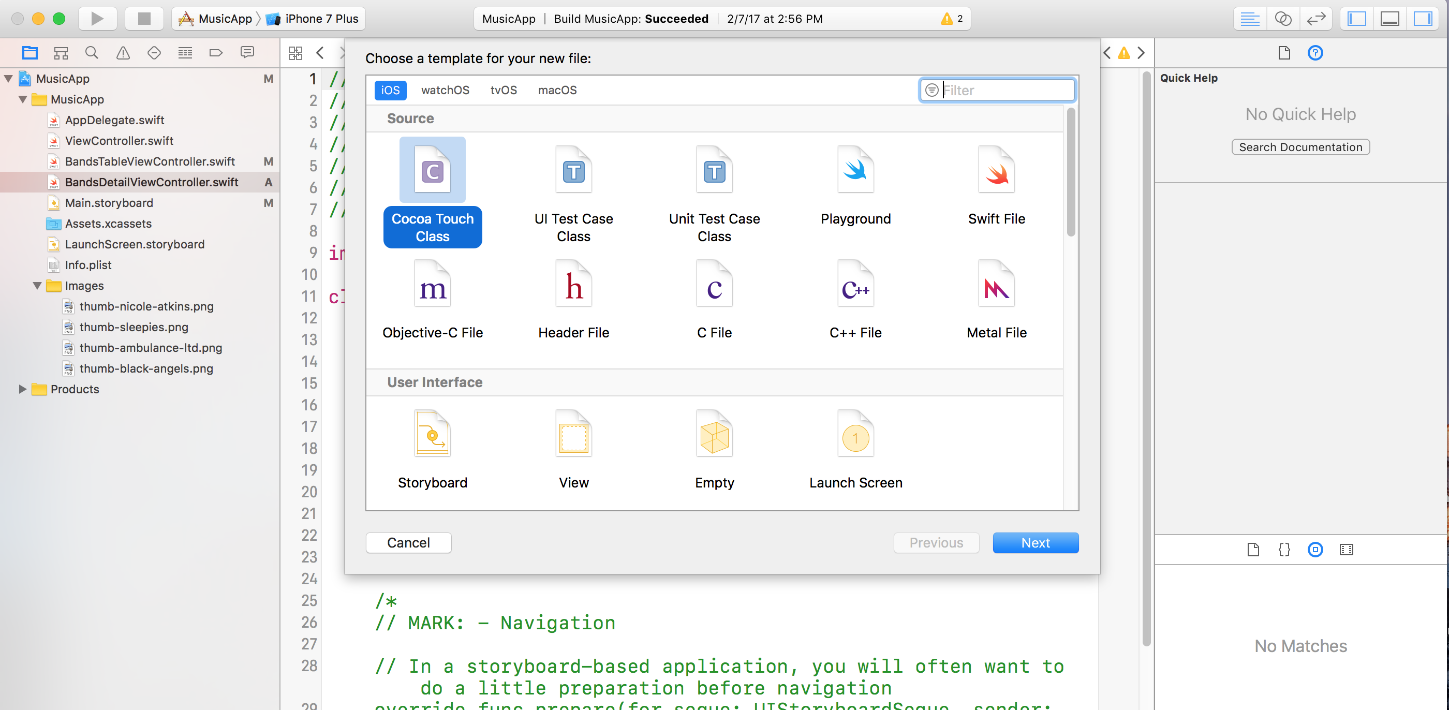
Band Detail Object
Notes:
We have quite a bit of information we need to pass along in the segue. The best way to do this is to create an object that will hold all the info for a single band and pass that between the Table View and Detail View controllers.
In the Project Navigator, select BandsDetailViewController.swift. (We want the file to be added after this file, that’s why we had you select it.)
Go to File > New > File (or hit Cmd–N).
Double–click Cocoa Touch Class to choose it.

Slide 9
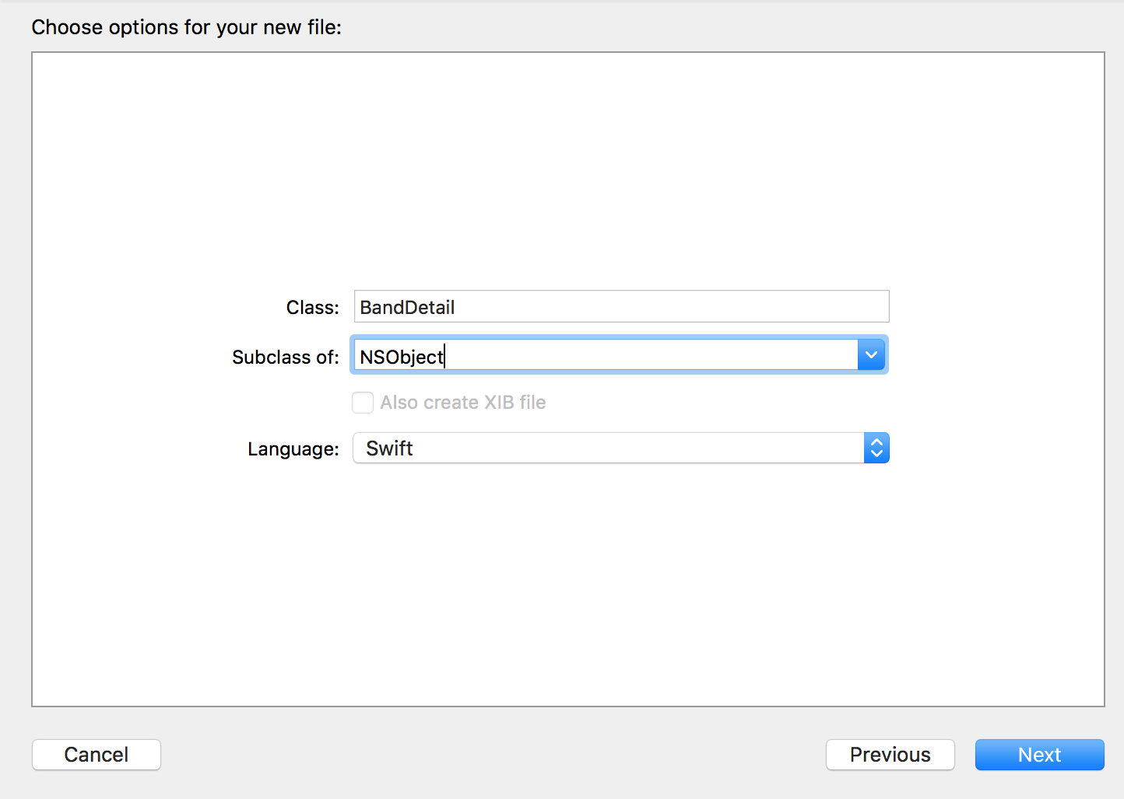
Notes:
From the Subclass of menu, choose NSObject (or start typing it and let Xcode autocomplete it for you).
Next to Class, type BandDetail (that is singular Band, not plural!).
Click Next.
You should already be in the Jive Factory folder, so click Create.
Notice that BandDetail.swift has been added in the Project Navigator.
Click on BandDetail.swift to open it if it isn’t already.

Slide 10
class BandDetail: NSObject {
var bandName:String?
var bandType:String?
var bandDescription:String?
var fullImageName:String?
var thumbImageName:String?
var nextShowDate:String?
var nextShowTime:String?
var venue:String?
var showDetails:String?
}
Notes:
Add to BandDetail.swift

Slide 11
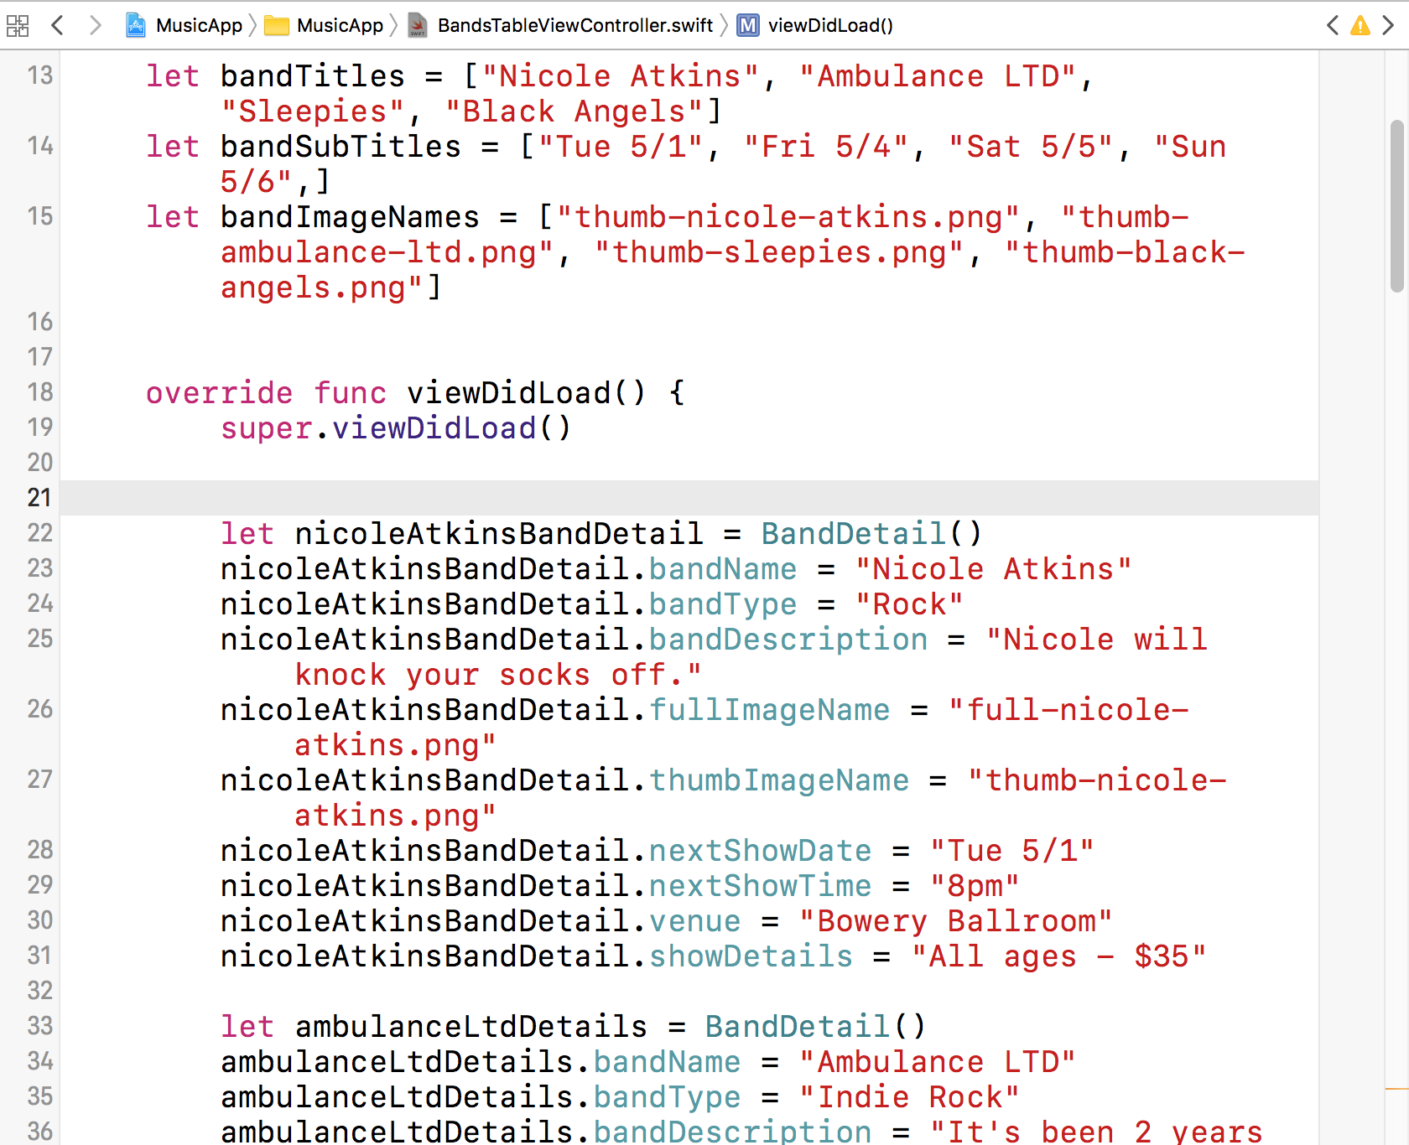
Notes:
Navigate to the Desktop > Class Files > yourname-iOS Dev Level 2 Class > Code
Snippets folder and open band-detail-objects.txt.
Press Cmd–A to select all the code.
Press Cmd–C to copy it.
Go to BandsTableViewController.swift.
Select and delete the commented out lines (around lines 20–24) in the super.viewDidLoad() method.
paste the code
Scroll through the code you just pasted. Note that each block of code creates a new object and sets its properties. The first line creates an object of the type BandDetail by allocating memory to it and initializing it. The rest of the code sets the different properties we created when we built the BandDetail class to the correct details for the band.

Slide 12
let bandImageNames = ["thumb-nicole-atkins.png", "thumb-ambulance-ltd.png", "thumb-sleepies.png", "thumb-black-angels.png"]
var bandDetails = [BandDetail]()
Notes:
We have the objects for our bands created, and now we need to be able to pass along the correct object depending on the row the user clicks. If you remember from a previous exercise, we used an array to hold the Titles for the different bands, then pulled the correct band title depending on what the user clicked. We need to do a similar thing for these objects. The arrays we created for bandTitles etc. are prefixed with let. When you use let you are creating a constant or immutable object. However, when you use var you are creating a mutable object. Only mutable objects are allowed to be updated after creation.
In the Project Navigator, click on BandsTableViewController.swift.
Below the bandImageNames property (around line 16), add the following bold code:
Notice that we use var in order to create a mutable object. We set the name of our
object to bandDetails and we set the object to an array that contains the type
BandDetail. In Swift an array must contain only one data type (in this case we set it
to our custom object of BandDetail).

Slide 13
blackAngelsDetails.showDetails = "Over 21 - $15"
bandDetails.append(nicoleAtkinsBandDetail)
bandDetails.append(ambulanceLtdDetails)
bandDetails.append(sleepiesDetails)
bandDetails.append(blackAngelsDetails)
}
Notes:
Now that we have the bandDetails mutable array to work with, let’s add the
BandDetail objects to it. Find the code for the last band object we created and add
the following bold code after it (around line 65):

Slide 15
class BandsDetailViewController: UIViewController {
var currentBandDetail:BandDetail?
override func viewDidLoad() {
Notes:
In BandsDetailViewController.swift.
At the top, around line 13, create a property called currentBandDetail by adding the bold code:
var currentBandDetail:BandDetail?

Slide 16
if (segue.identifier == "showDetail") {
if let indexPath = self.tableView.indexPathForSelectedRow {
let bandsDetailViewController:BandsDetailViewController = segue.destination as! BandsDetailViewController
bandsDetailViewController.currentBandDetail = bandDetails[indexPath.row]
}
}
Notes:
We are setting the currentBandDetail object in the bandsDetailViewController equal to the object in the bandDetails mutable array
at the specified indexPath.row. It figures out the correct indexPath.row based on the row that is clicked.
Which we set in the first line of the code in the if statement.
Next we’ll get all the labels in the Detail View Controller displaying the correct info from the object that’s passed.

Slide 17
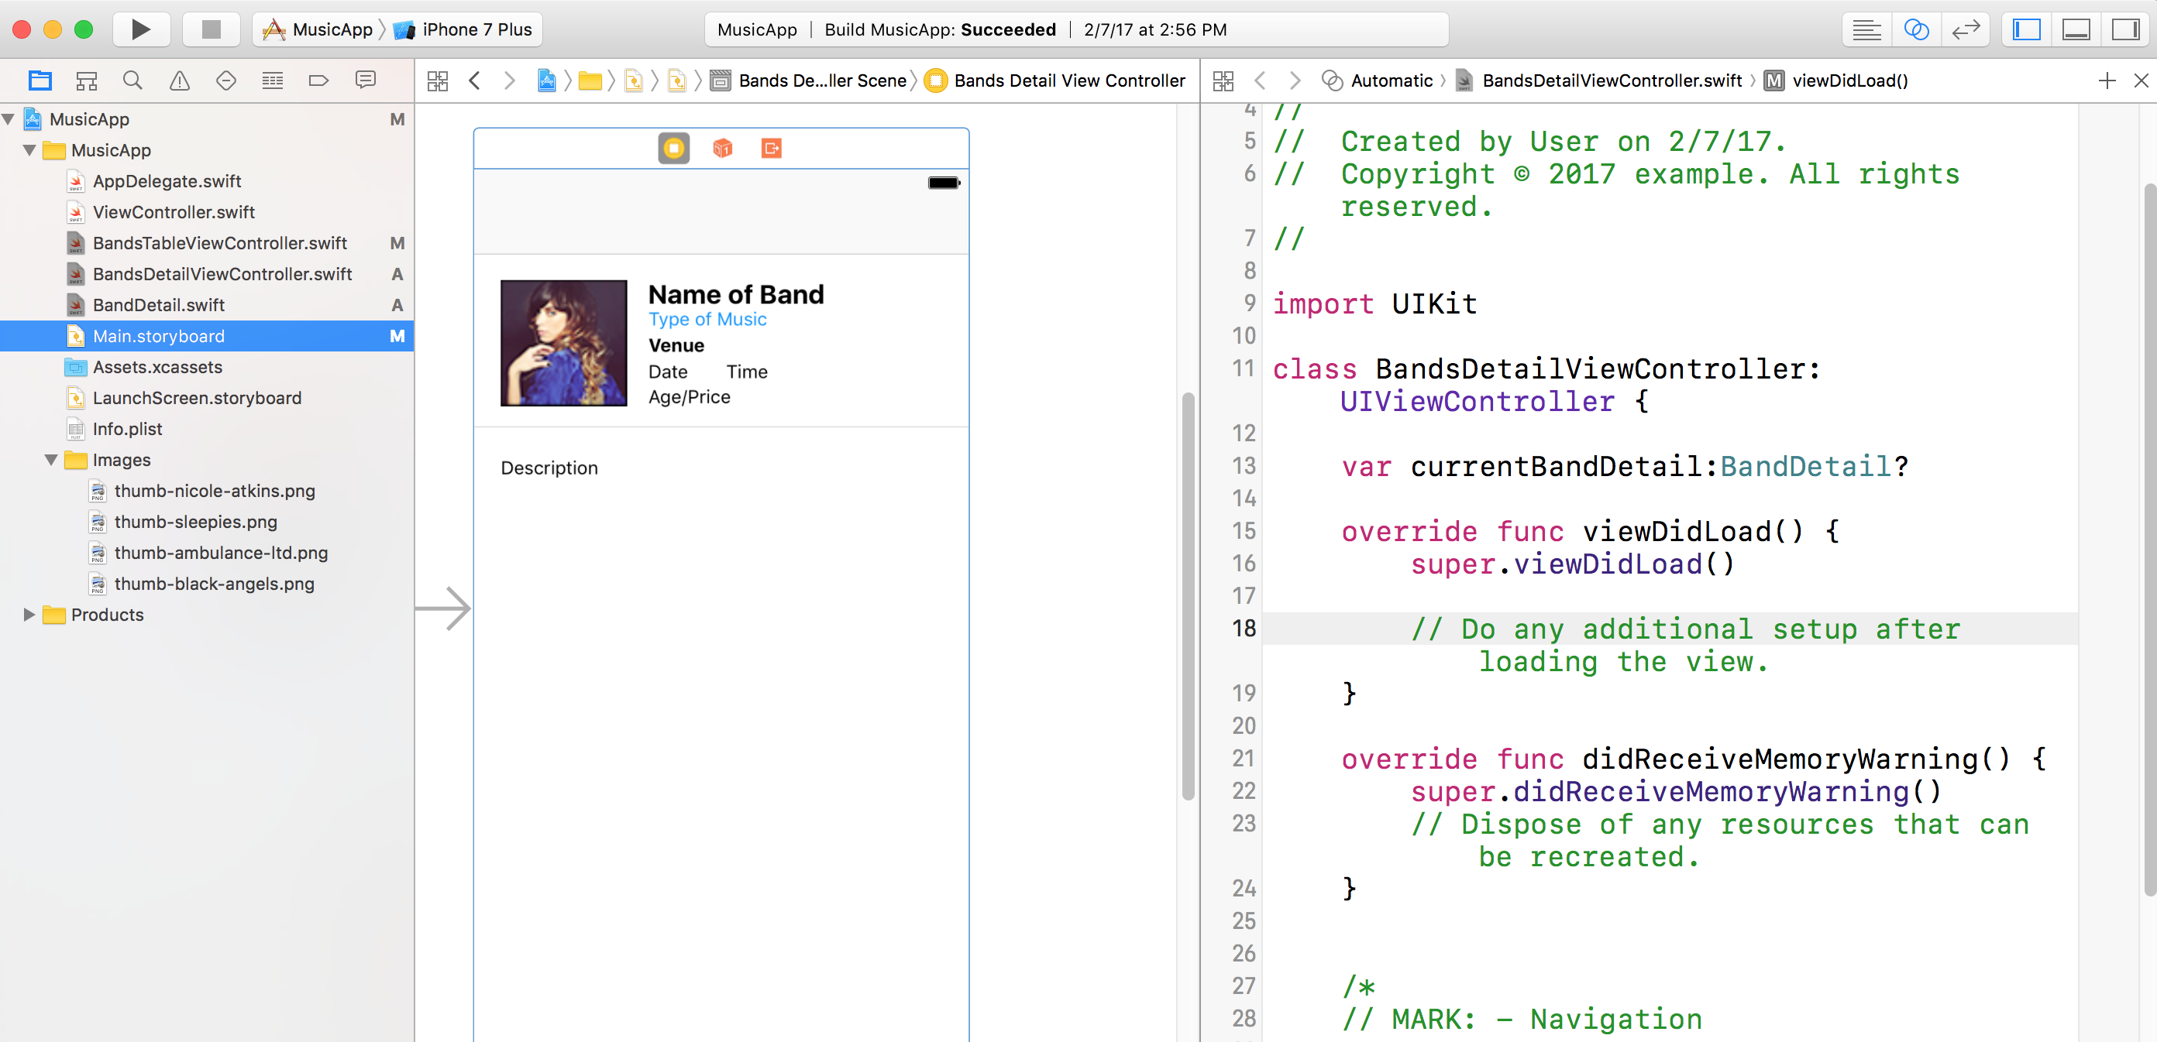
Notes:
In the Project Navigator click on Main.storyboard.
2. If the Document Outline is open, click Hide Document Outline .
3. Click the top bar of the Bands Detail View Controller so that it is selected in the
Editor area.
4. At the top right of the window, click on the Assistant editor button because we
want to see the storyboard next to BandsDetailViewController.swift.
5. If BandsDetailViewController.swift isn’t showing on the right side, choose it from
the menu at the top of the code.

Slide 18
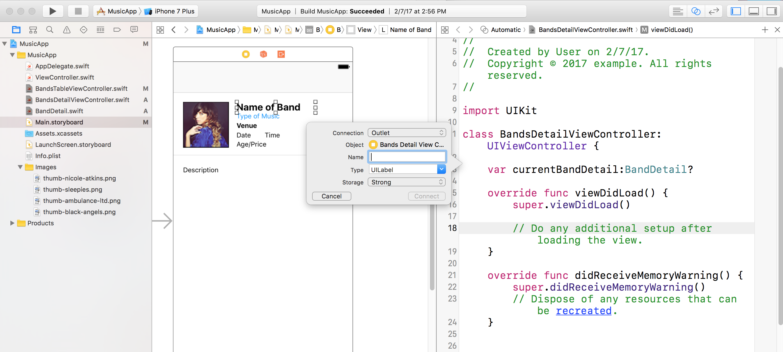
Notes:
You should now have the storyboard showing on the left and
BandsDetailViewController.swift on the right. We are going to create outlets for
each of the elements on this page.
7. In the storyboard, make sure you can see the Bands Detail View Controller with all
the placeholder labels (Name of Band, Type of music, etc.). You’ll probably have to
scroll over to the right side of the storyboard.
8. As shown below, hold Ctrl and drag the Name of Band label to the
BandsDetailViewController.swift file beneath the BandDetail property line. (You can
also use the Right mouse button to drag instead of holding Ctrl.)

Slide 19
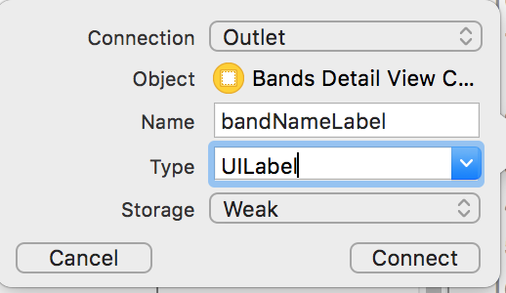
Notes:
In the menu that pops up, set the following:
• Name: bandNameLabel
• Storage: Weak
10. Click Connect (or hit Return).

Slide 20
• Type of music: bandTypeLabel
• Venue: venueLabel
• Date: showDateLabel
• Time: showTimeLabel
• Age / price: showDetailsLabel
• Description: bandDescriptionLabel
• Band image: bandImage
Notes:
Repeat this same process for the rest of the labels and the image, adding each just
below the previous one. In the pop up menu, set Storage to Weak and Name to the
following values:

Slide 21
var currentBandDetail:BandDetail?
@IBOutlet weak var bandNameLabel: UILabel!
@IBOutlet weak var bandTypeLabel: UILabel!
@IBOutlet weak var venueLabel: UILabel!
@IBOutlet weak var showDateLabel: UILabel!
@IBOutlet weak var showTimeLabel: UILabel!
@IBOutlet weak var showDetailsLabel: UILabel!
@IBOutlet weak var bandDescriptionLabel: UILabel!
@IBOutlet weak var bandImage: UIImageView!
override func viewDidLoad() {
Notes:
When finished, the code you added should look like this:

Slide 22
override func viewDidLoad() {
super.viewDidLoad()
// Do any additional setup after loading the view.
bandNameLabel.text = currentBandDetail?.bandName
bandTypeLabel.text = currentBandDetail?.bandType
venueLabel.text = currentBandDetail?.venue
showDateLabel.text = currentBandDetail?.nextShowDate
showTimeLabel.text = currentBandDetail?.nextShowTime
showDetailsLabel.text = currentBandDetail?.showDetails
bandDescriptionLabel.text = currentBandDetail?.bandDescription
bandImage.image = UIImage(named: currentBandDetail!.thumbImageName!)
}
Notes:
In the Project Navigator, select BandsDetailViewController.swift.
15. Find the viewDidLoad method around line 24 and add the following bold code:

Slide 23
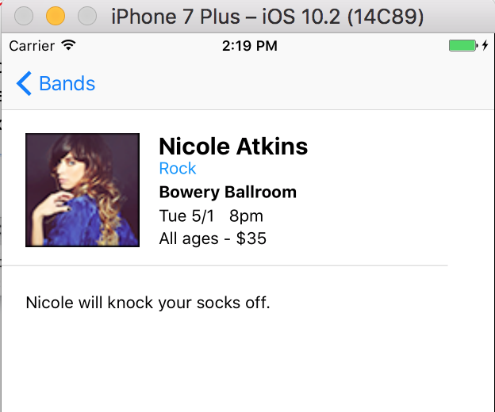
Notes:
Click the Run button (and click Stop if asked).
17. When the Simulator loads, click on Nicole Atkins.
The detail view will load. It should now be populated with the correct info!
18. Click on the Bands button at the top left to go back to the list of bands.
19. Click on another band to go to the detail view and see it is populated with the
correct info for that band as well.
Notice the description at the bottom gets cut off. There should be two lines of
description. Let’s fix that.
20. Switch back to Xcode.
21. Click the Stop button.

Slide 24
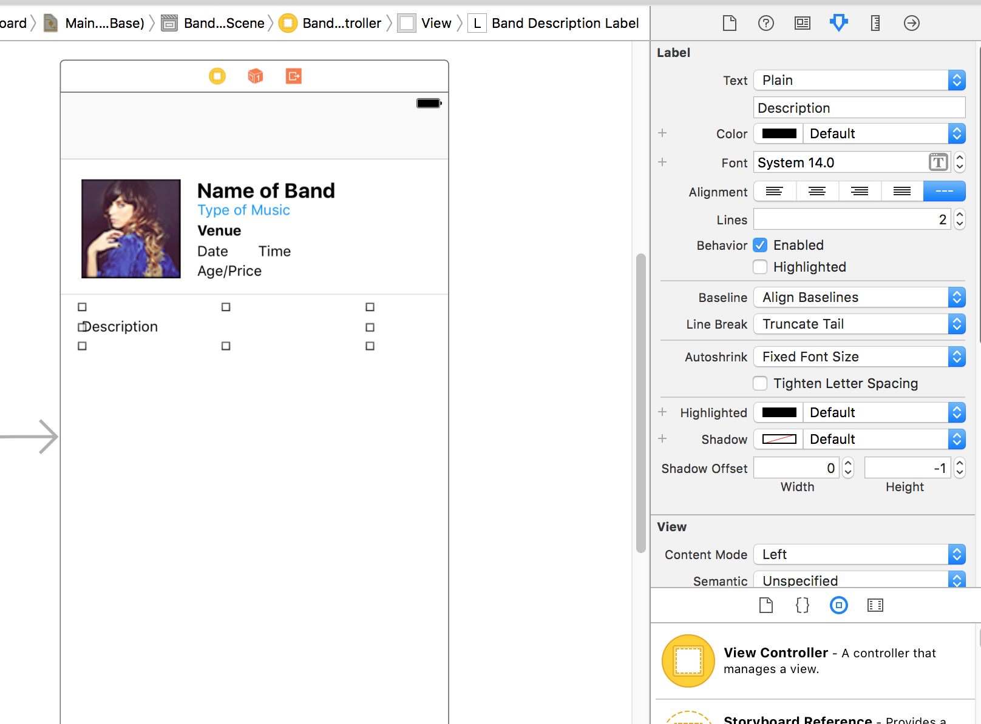
Notes:
In the Project Navigator, click on Main.storyboard to view it.
(If you don’t see it, click the Project Navigator tab .)
23. Click on the Description label to select it on the view.
24. In the Attributes inspector , set Lines to 2 and hit Return.
NOTE: This specifies the line limit. If the text is longer than the limit, it will be
truncated and an ellipse (…) will be added at the end of the text. Setting the limit to
0 would give you an unlimited number of lines.
25. Click the Run button.
26. Click on any band (except for Nicole Atkins, which only has one line of content) to
switch to the detail view. Notice the full 2-line description is now listed.

Slide 25
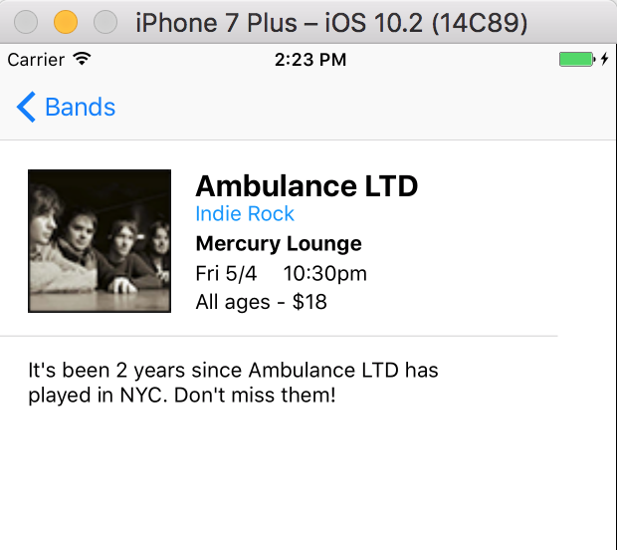
Notes:
In the Project Navigator, click on Main.storyboard to view it.
(If you don’t see it, click the Project Navigator tab .)
23. Click on the Description label to select it on the view.
24. In the Attributes inspector , set Lines to 2 and hit Return.
NOTE: This specifies the line limit. If the text is longer than the limit, it will be
truncated and an ellipse (…) will be added at the end of the text. Setting the limit to
0 would give you an unlimited number of lines.
25. Click the Run button.
26. Click on any band (except for Nicole Atkins, which only has one line of content) to
switch to the detail view. Notice the full 2-line description is now listed.

Slide 26
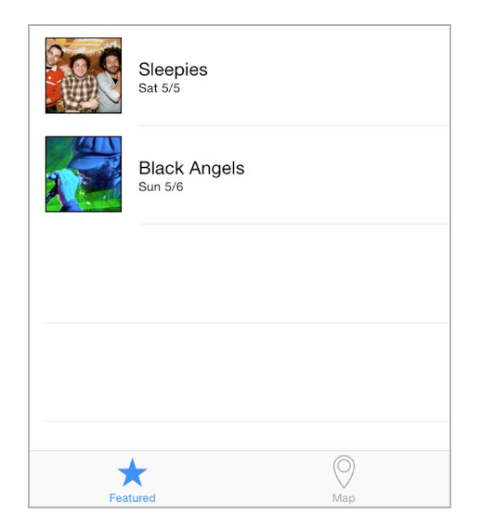
Notes:
In this exercise, we’ll add a tab bar at the bottom of our Jive Factory app. The first
tab will have the list of upcoming shows. The second tab will have a map with the
location of the Jive Factory.

Slide 27
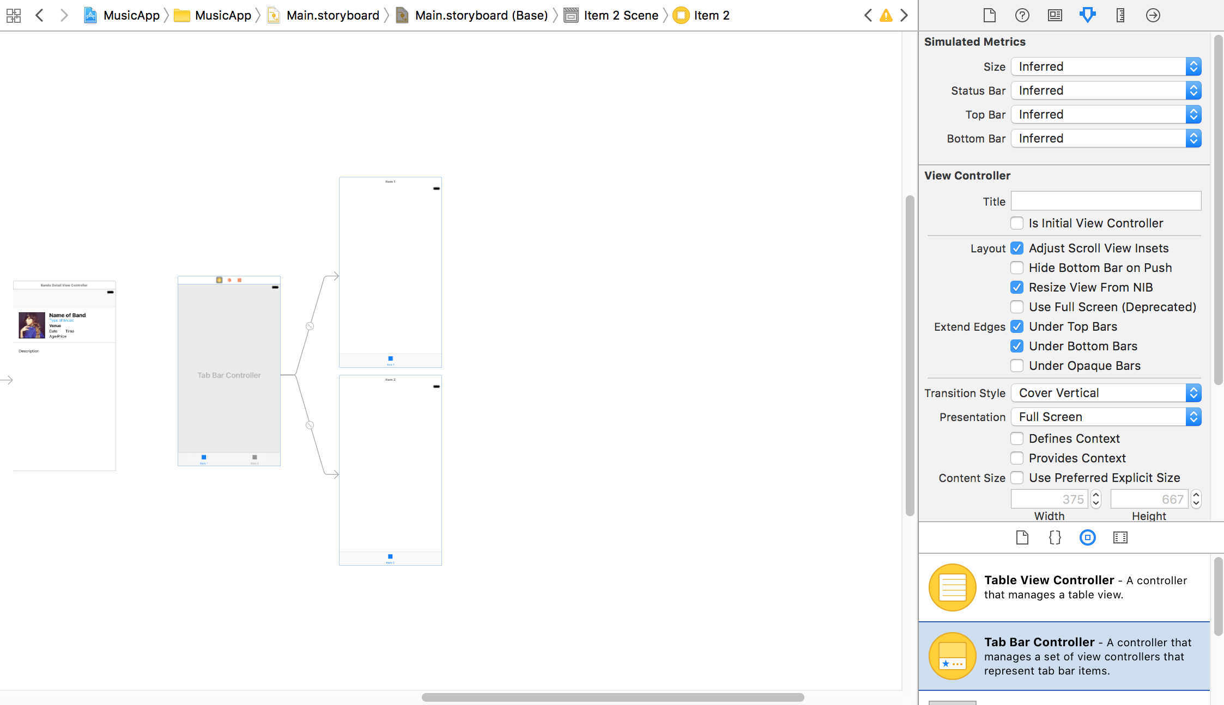
Notes:
In the Project Navigator, click on Main.storyboard.
2. If the Document Outline is open, click Hide Document Outline .
3. We’re going to drag out a large object, so let’s zoom out a bit. Ctrl–click or Right–
click on a blank area of the Editor. In the menu, choose Zoom to 50%.
4. In the search bar at the bottom of the Object library , type: tab bar
5. Drag a Tab Bar Controller from the Object library onto the Editor area, to the left of
the current controllers. (Don’t worry about the specific position, we’ll adjust
it shortly.)
6. If the Document Outline popped open again, click Hide Document Outline .

Slide 28
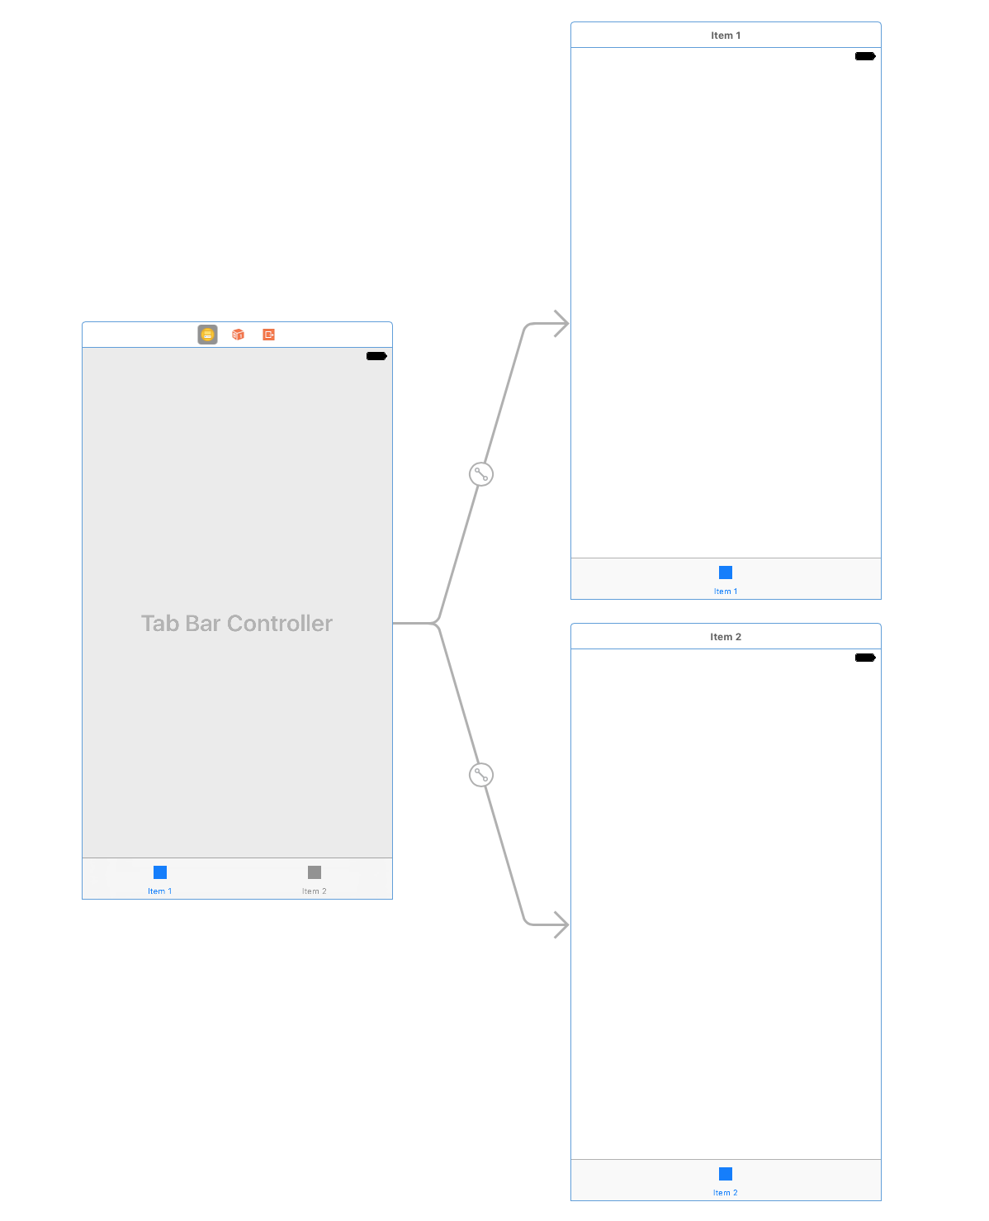
Notes:
Notice Tab Bar Controller comes with the main controller (on the left) plus two view
controllers (stacked on top of each other on the right) that are associated with two
tabs called Item 1 and Item 2.
We want the Item 1 tab to be associated with our featured band listings, rather than
using the default provided controller.
9. In the Editor, click anywhere on the white background (outside the controller) to
deselect the Tab Bar Controller.
10. Click on the top of the Item 1 view controller (the top controller on the right of the
new group you just pulled out) so that it is selected and outlined in blue.
11. Hit Delete.

Slide 29
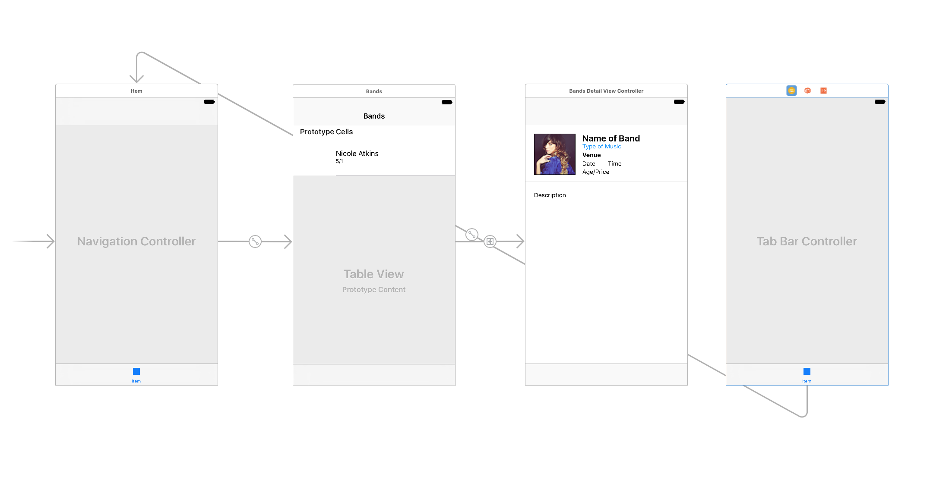
Notes:
Click on the Tab Bar Controller so it’s outlined in blue.
13. Keep the Tab Bar Controller selected, but make sure you can also see the
Navigation Controller (the leftmost of our first three controllers).
14. In the Utilities area on the right, click on the Connections inspector tab .
15. Under Triggered Segues, to the right of view controllers, hover over Item 2 and click
the x to delete it as shown below.
There should now be nothing connected to view controllers under Triggered Segues.
16. With the Tab Bar Controller still selected, under Triggered Segues, hover over the
circle to the far right of view controllers. A + sign will appear in the circle.
17. Hold Ctrl and drag from the + to the Navigation Controller in the Editor area,
then release.

Slide 30
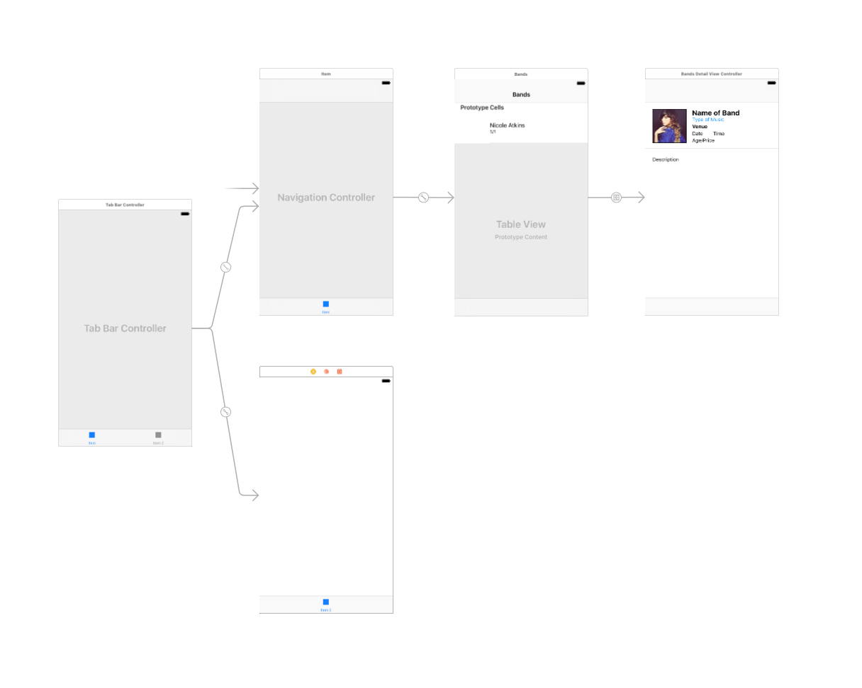
Notes:
We also need to link it to Item 2. Hover over the circle to the far right of Item.
19. Hold Ctrl, drag from the + and release over the Item 2 controller in the Editor area.
20. The two controllers should now have segues from the Tab Bar Controller as
shown below:
21. Let’s tidy up our work area. Arrange the controllers in the Editor as shown below:

Slide 31
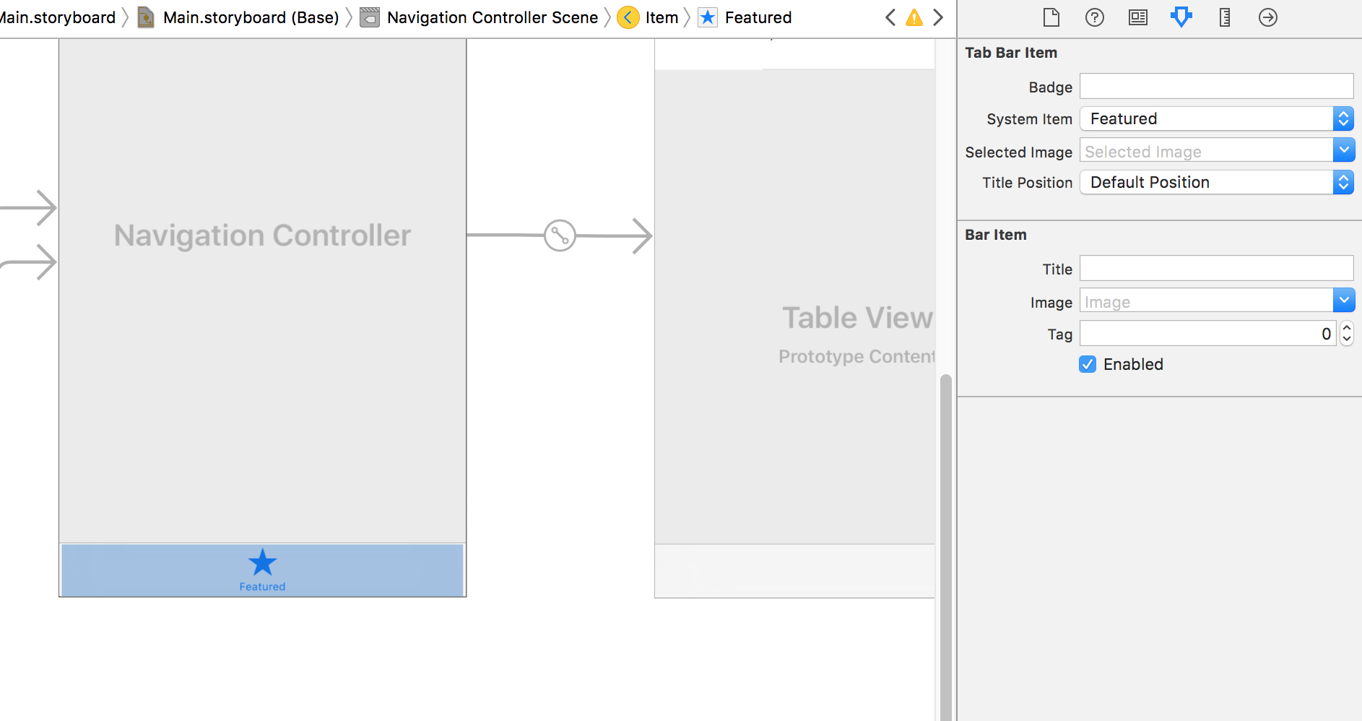
Notes:
We can have different images for each tab bar item. At the bottom of the
Navigation Controller click on the gray box that says Item below it to select it.
In the Attributes inspector , from the System Item menu, choose Featured.
25. Notice a Featured icon now appears at the bottom of the Navigation Controller:

Slide 32
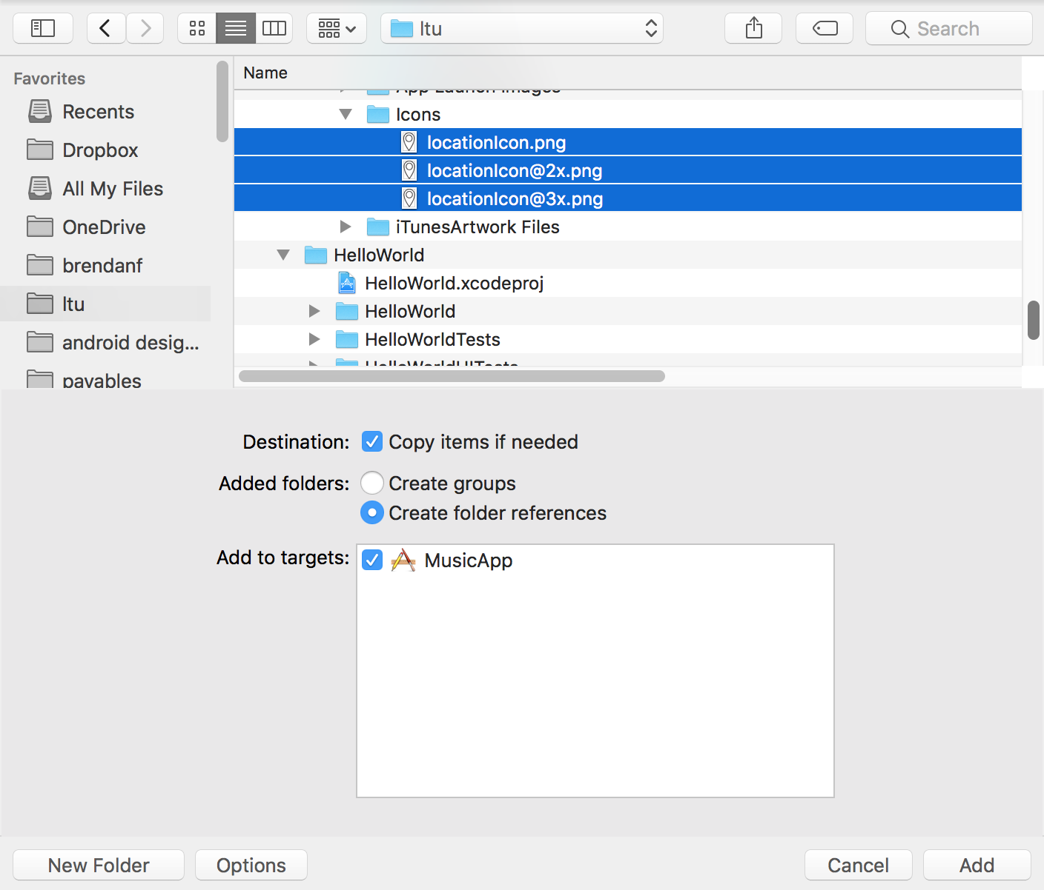
Notes:
Later, we’ll be creating a location map. There isn’t a default map icon, but we can
add our own custom icon.
Go to File > Add Files to “Jive Factory”.
3. Navigate to Desktop > Class Files > yourname-iOS Dev Level 2 Class > Icons.
4. Hit Cmd–A to select all the images in that folder.
5. At the bottom of the window, click Options, then set the following:
• Destination: Check on Copy items if needed.
• Added folders: No folders are being added, so leave as is.
• Add to targets: Check on Jive Factory.
6. Click Add.
7. In the Project Navigator, the files have been added to the Images folder.

Slide 33
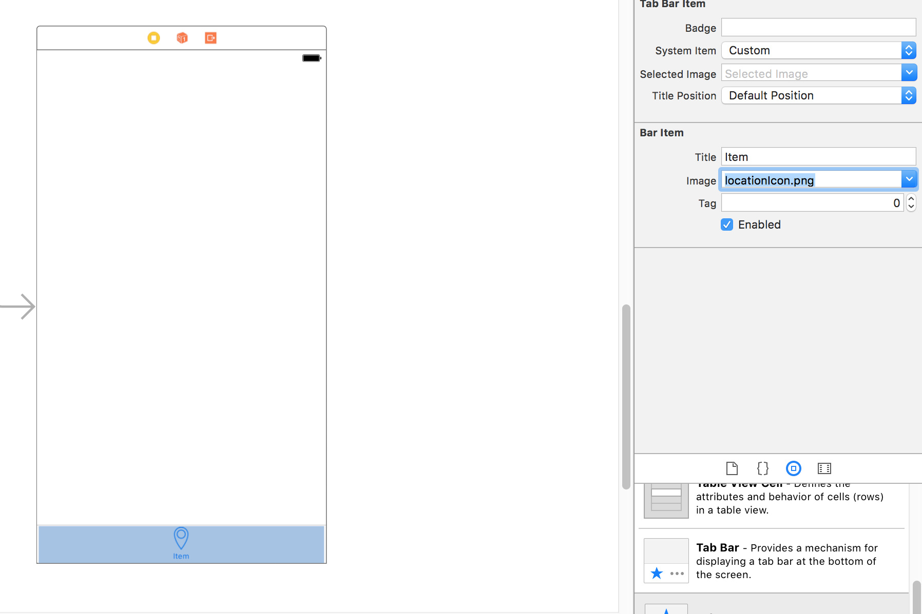
Notes:
In the Project Navigator, the files have been added to the Images folder.
8. In the Project Navigator, click on Main.storyboard.
9. In the Object library , find Tab Bar Item and drag it onto the Item 2 controller in
the Editor.
10. The new Tab Bar Item should be selected (the gray box at the bottom of the
controller will be gray-blue). If not, click on it to select it.
11. In the Attributes inspector under Bar Item set the following:
• Next to Title delete any existing text, type Map and hit Return.
• From the Image menu, choose locationIcon.png.
12. As shown below, you should now have the Map icon on the tab bar of the
View Controller.

Slide 34
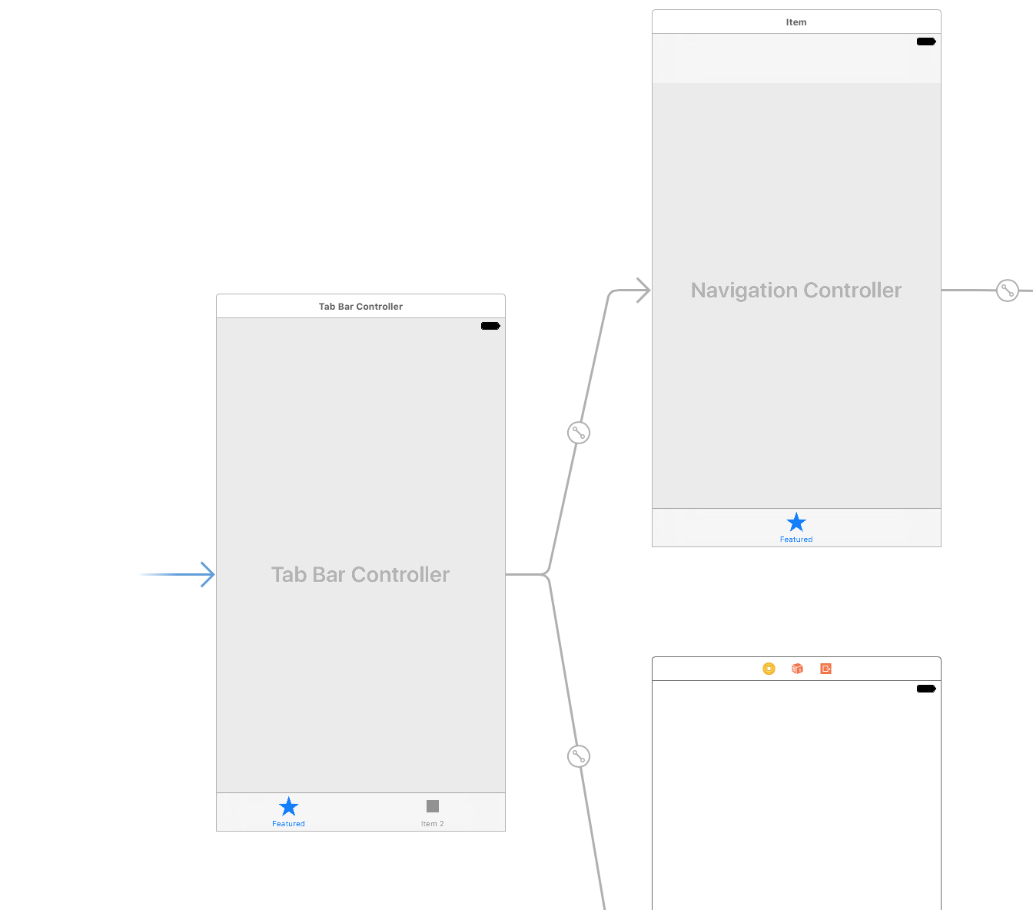
Notes:
We need to change the Tab Bar Controller to be the Initial View Controller (right
now it’s set to the Navigation Controller). Drag the gray arrow that is currently to the
left of the Navigation Controller and drop it on the Tab Bar Controller.
You should end up with the arrow pointing to the Tab Bar Controller.
14. Let’s preview what we have so far. Click the Run button.

Slide 35
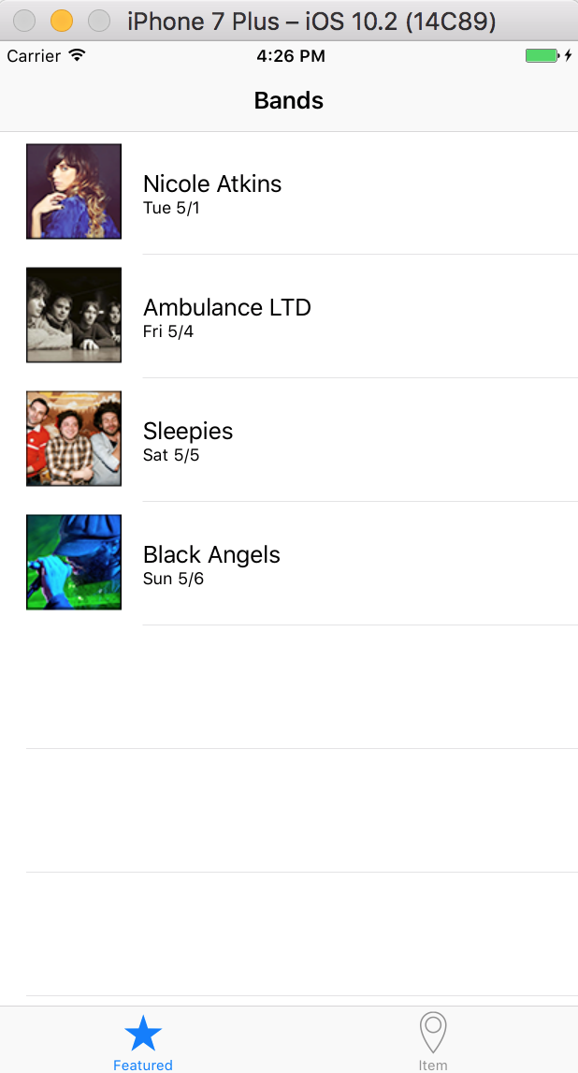
Notes:
When the Simulator finishes loading, notice that the list of bands is now in a
Featured tab (shown at the bottom).
16. Click the Map tab to switch to it. There is no content in the Map tab yet, but that’s
what we’ll be building in the next exercise!

Slide 36
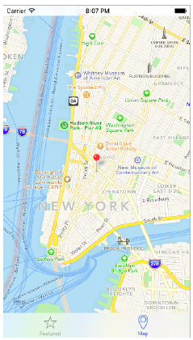
Notes:
In this exercise, we’ll add a map to our app showing the location of the Jive Factory.

Slide 37
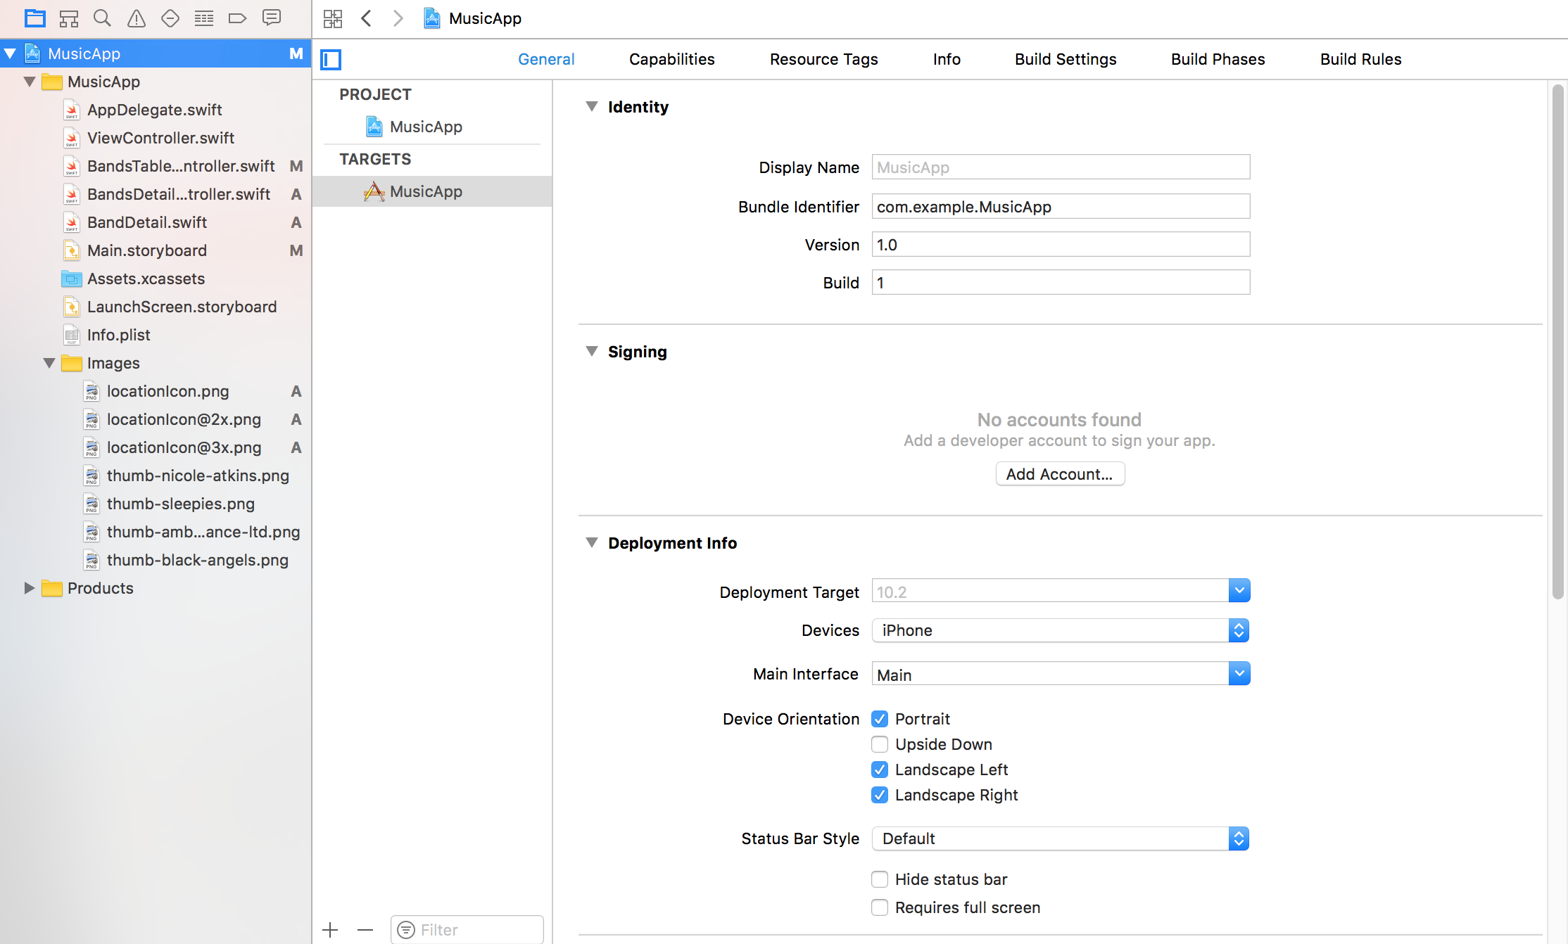
Notes:
In order to have a map in our app, we need to add an Apple-provided framework,
called the MapKit.framework, to our project. It will give us additional functionality
for manipulating the map such as zooming and pinpointing locations. A framework
can be a collection of libraries or a collection of code, and it can contain new UI
elements or images.
1. Click on the Jive Factory project name in the Project Navigator. This opens the
Project Settings Editor.

Slide 38
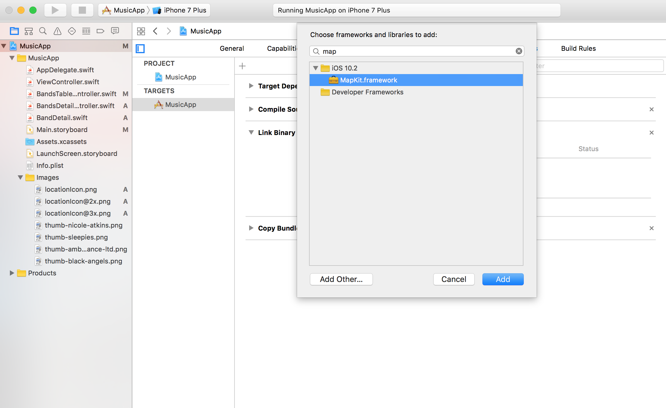
Notes:
Slightly to the right of the Project Navigator, to the left of General, make sure
Jive Factory is selected as a Target.
3. Click on the Build Phases tab at the top.
4. Expand the Link Binary With Libraries section.
5. Towards the bottom left of the section, click on the Add items button .
6. In the search bar at the top, type: map
7. In the results, double–click on MapKit.framework to add it.
8. In the Project Navigator, notice MapKit.framework has been added.

Slide 39
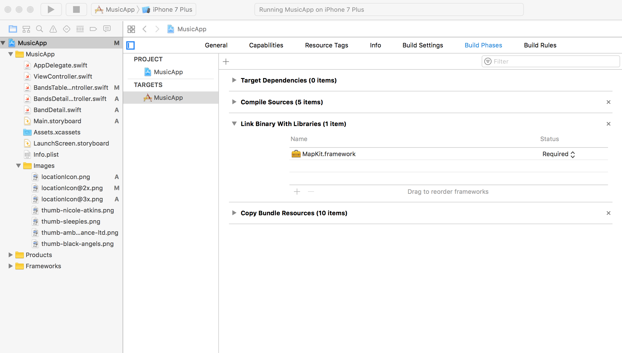

Slide 40
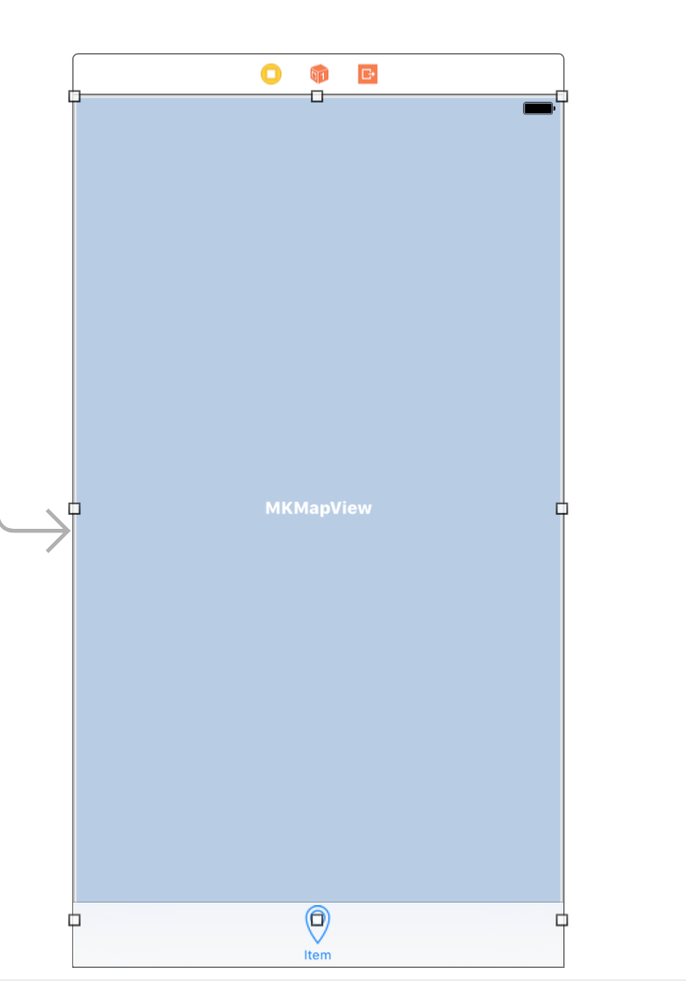
Notes:
In the Project Navigator, click on Main.storyboard.
2. In the Object library search, type in: map
3. From the Object library , drag Map Kit View onto the Map View Controller in the
Editor area. Be careful not to drag onto the bottom of the view (where the tab is) or
position it so that it overwrites the existing view. It should look something like this
when you’re dragging:
TIP: If you accidentally overwrote the existing view, hit Cmd–Z to undo and try
adding the Map Kit View again.
4. We want the map to fill the iPhone screen. Drag out the handles to resize the Map
View to the size of the screen.
5. Make sure the Map Kit View is still selected in the Editor.

Slide 41
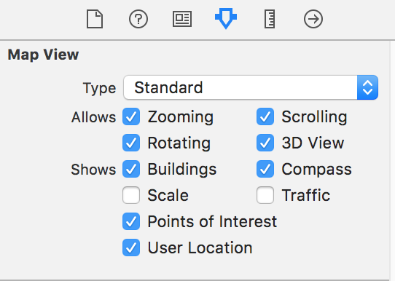
Notes:
In the Utilities area, click on the Attributes inspector tab .
7. In the Map View section, next to Shows check on User Location.
8. Let’s test this out. Click the Run button.

Slide 42
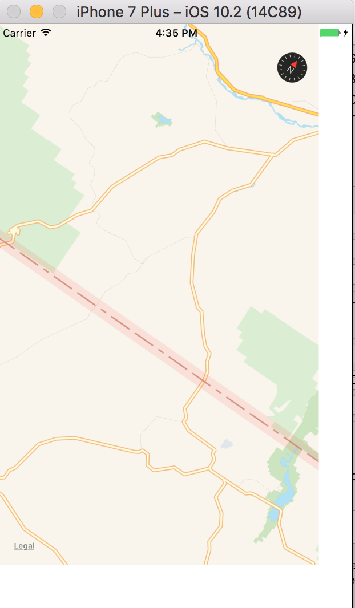
Notes:
In the Utilities area, click on the Attributes inspector tab .
7. In the Map View section, next to Shows check on User Location.
8. Let’s test this out. Click the Run button.
9. When the Simulator finishes loading, click on the Map tab.
10. If you get an alert asking to use your current location, click OK.
Because we are using the Simulator, it will not show our current location. On a
phone, it would show the user’s actual location.
11. Let’s test out the zooming. To simulate zooming in the Simulator, hold Option. Two
gray circles (representing two fingertips in a pinching action) will appear. Click and
drag the mouse to simulate pinching. Cool!

Slide 43
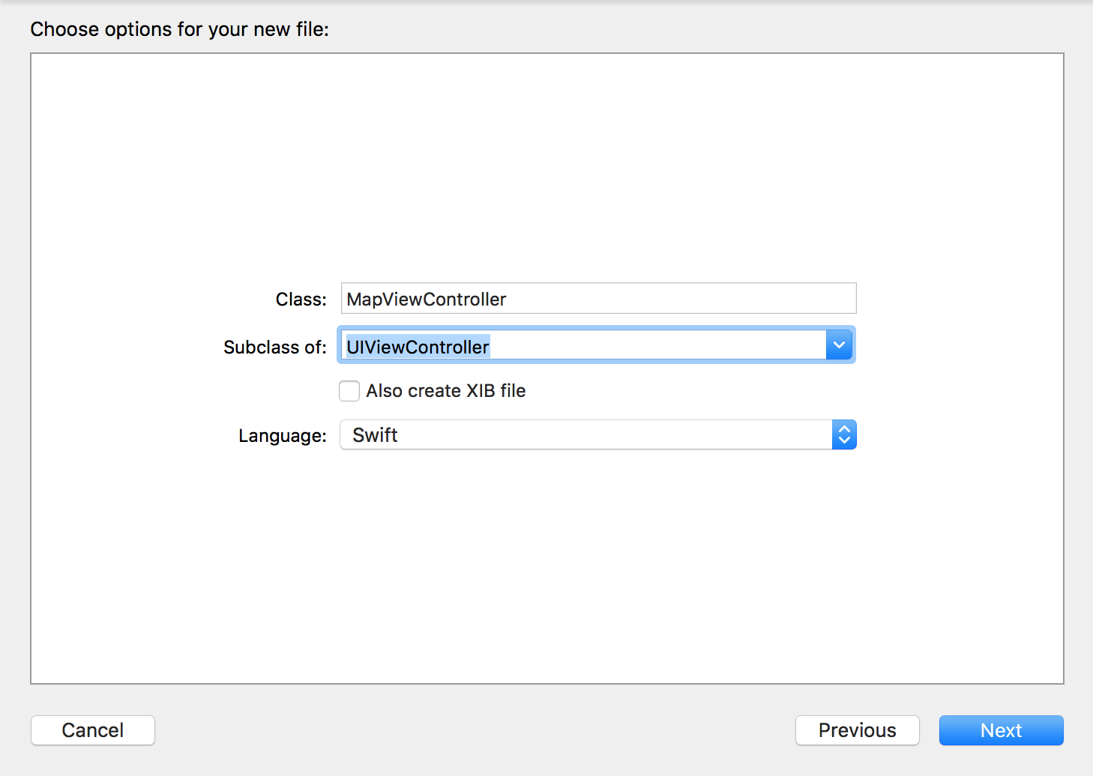
Notes:
Switch back to Xcode.
2. In the Project Navigator, select BandDetail.swift. (We want the file to be added after
this file, that’s why we had you select it.)
3. Hit Cmd–N.
4. Double–click Cocoa Touch Class to choose it.
5. From the Subclass of menu, choose UIViewController (or start typing it and let
Xcode autocomplete it for you).
6. Edit the name of the Class to be: MapViewController
7. Click Next.
8. You should already be in the Jive Factory folder, so click Create.
9. Notice MapViewController.swift has been added in the Project Navigator.

Slide 44
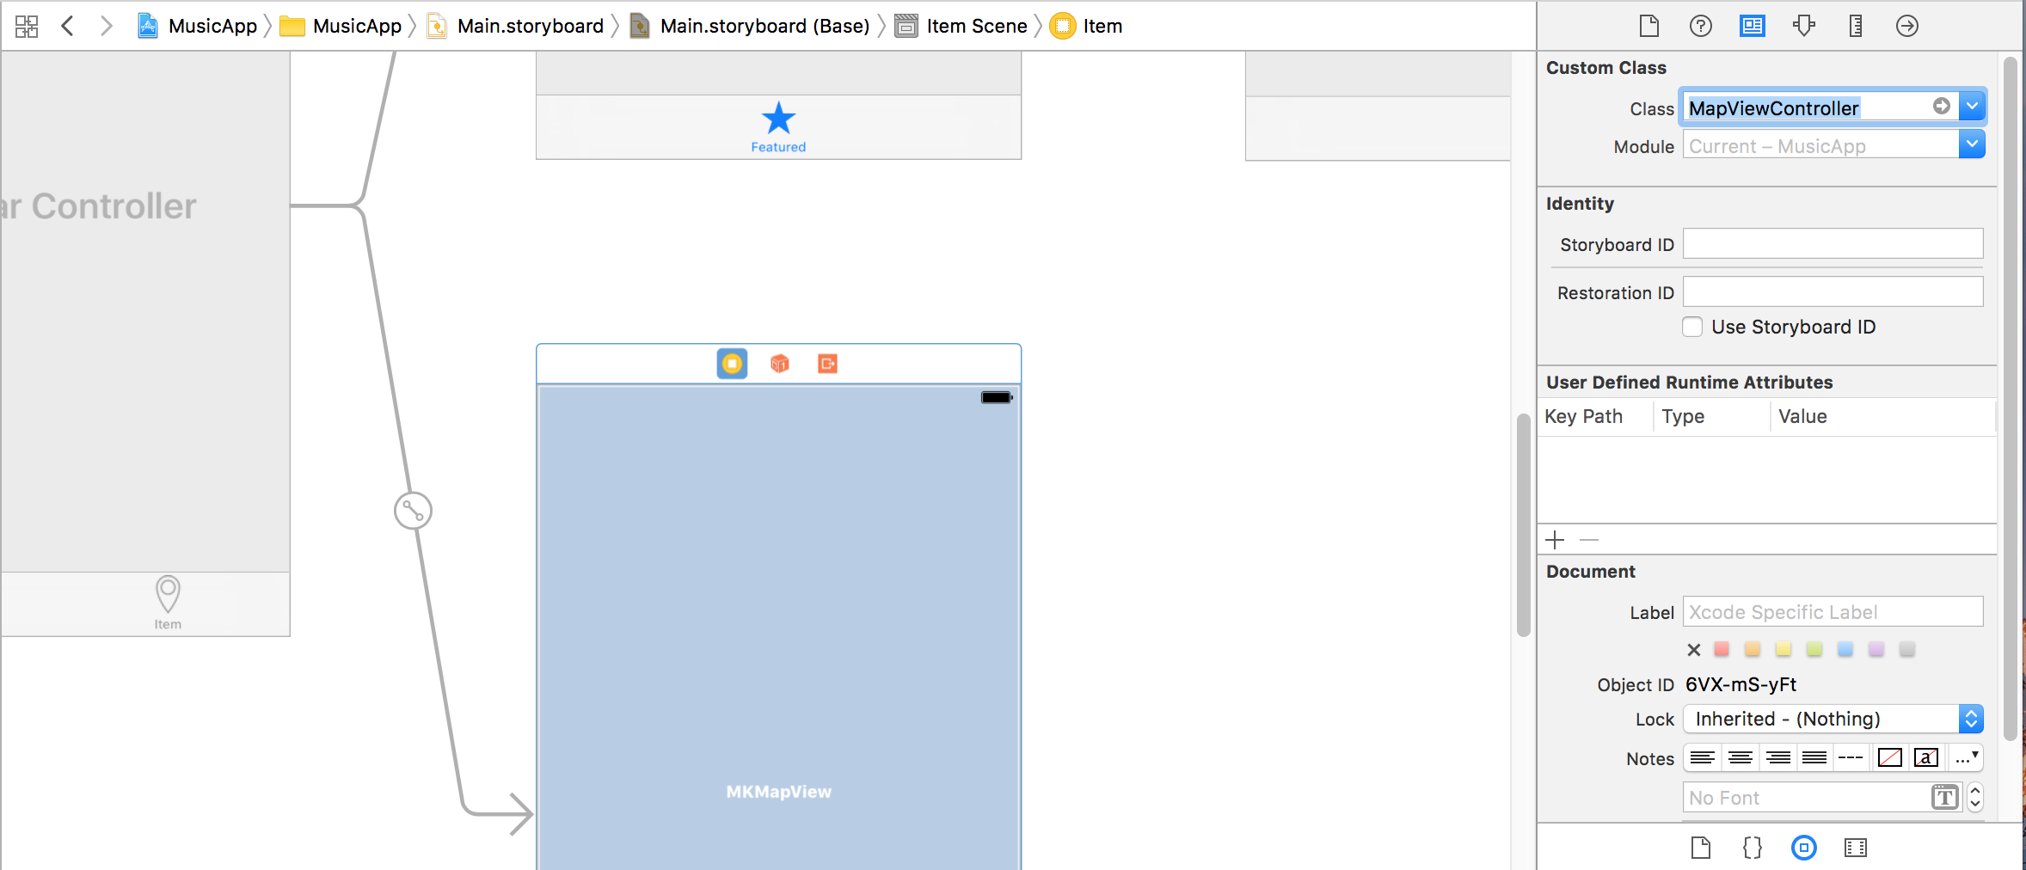
Notes:
10. In the Project Navigator, click on Main.storyboard.
11. Deselect everything by clicking on a blank area of the Editor.
12. Select the Map View Controller by clicking on the battery icon , giving the
controller a blue outline.
13. In the Utilities area, click on the Identity inspector tab .
Under Custom Class, next to Class, start typing Map. Xcode should autocomplete to
MapViewController and you can hit Return to apply it. (If it doesn’t autocomplete,
just type it.)

Slide 45
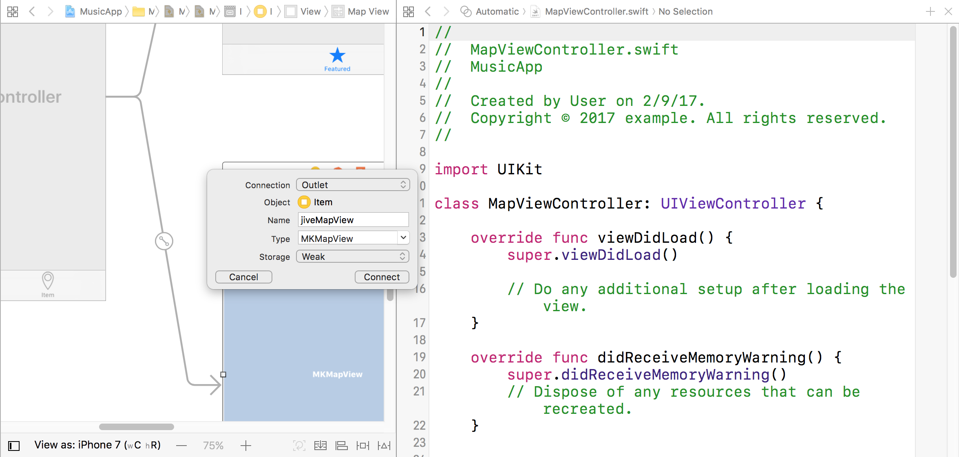
Notes:
15. If the Document Outline is open, click Hide Document Outline .
16. At the top right of the window, click on the Assistant editor button .
17. MapViewController.swift should be shown on the right. If MapViewController.swift
isn’t showing in the Assistant editor, click the menu bar at the top of the file and
choose it.
18. Hold Ctrl and drag from the Map View on the Map View Controller, releasing in the
code below class MapViewController: UIViewController { as shown below:
In the menu that pops up, set the following:
• Connection: Outlet
• Name: jiveMapView
• Type: MKMapView
• Storage: Weak
20. Click Connect.

Slide 46
Notes:
15. If the Document Outline is open, click Hide Document Outline .
16. At the top right of the window, click on the Assistant editor button .
17. MapViewController.swift should be shown on the right. If MapViewController.swift
isn’t showing in the Assistant editor, click the menu bar at the top of the file and
choose it.
18. Hold Ctrl and drag from the Map View on the Map View Controller, releasing in the
code below class MapViewController: UIViewController { as shown below:
In the menu that pops up, set the following:
• Connection: Outlet
• Name: jiveMapView
• Type: MKMapView
• Storage: Weak
20. Click Connect.

Slide 47
import UIKit
import MapKit
class MapViewController: UIViewController {
@IBOutlet weak var jiveMapView: MKMapView!
Notes:
Still in MapViewController.swift, below the import UIKit statement (around line 10)
add the following bold code:
import UIKit
import MapKit
class MapViewController: UIViewController {
@IBOutlet weak var jiveMapView: MKMapView!

Slide 48
class MapViewController: UIViewController {
let jiveLatitude = 40.72004
let jiveLongitude = -74.003912
let jiveSpan = 0.05
@IBOutlet weak var jiveMapView: MKMapView!
Notes:
5. Close the file.
6. In the Project Navigator, select MapViewController.swift.
7. Find the @IBOutlet weak var jiveMapView: MKMapView! (around line 13).
8. Make some space above it, then paste the code as shown below:

Slide 49
override func viewDidLoad() {
super.viewDidLoad()
var jiveRegion = MKCoordinateRegion()
}
Notes:
We’re going to use classes provided for us in the MapKit.framework to specify our
location. First we are going to use the MKCoordinateRegion class. An
MKCoordinateRegion is made up of a center point and a span.

Slide 50
override func viewDidLoad() {
super.viewDidLoad()
// Do any additional setup after loading the view.
var jiveRegion = MKCoordinateRegion()
var center = CLLocationCoordinate2D()
center.latitude = jiveLatitude
center.longitude = jiveLongitude
var span = MKCoordinateSpan()
span.latitudeDelta = jiveSpan
span.longitudeDelta = jiveSpan
jiveRegion.center = center
jiveRegion.span = span
jiveMapView.setRegion(jiveRegion, animated: true)
}
Notes:
We need to create a center point for our region.
After that, add the following code to set the center’s latitude and longitude:
Below that, add the following bold code to create a span:
After that add the following bold code to set the span’s latitude and longitude:
Next we need to set the center and span values back onto the jiveRegion object.
Lastly, we need to reference the map view and set the region on it to our region.

Slide 51
override func viewDidLoad() {
super.viewDidLoad()
// Do any additional setup after loading the view.
……
let jivePoint = MKPointAnnotation()
jivePoint.coordinate = center
jivePoint.title = "The Jive Factory"
jivePoint.subtitle = "580 Lispenard, NY, NY 10013"
jiveMapView.addAnnotation(jivePoint)
}
Notes:
After the Simulator loads, click the Map tab. The map is centered over the Jive
Factory’s location in New York, but it’s missing the location indicator/pin. That’s
because we still need to create an annotation.
After the code we added to set the region to our region, add the following bold code
to create an annotation (around line 35):
We need to set three values on this annotation (coordinate, title, subtitle). Add the
following bold code:
Finally, we need to add this annotation to our map. Add the following bold code:
RUN!

Slide 52
Agenda
Chapter 5 and 6 from Nobledesktop book

